Slide 1
Samad, Guandong, and Tyler
Brain Stimulator Progress Update

Slide 2
Problem Description
Make a device that can generate waveforms of precise frequency and current to stimulate deep parts of the brain using electrodes.

Slide 3
Key Events from Last Week
Continued testing with MCU
Looked at pinout
Got DDS samples
Continued schematic creation

Slide 4
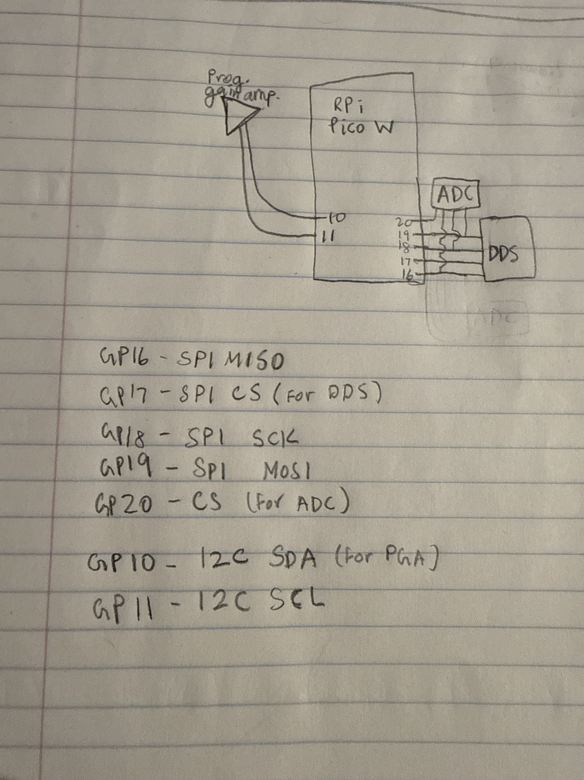
MCU Pinout
Don’t need many operations outside of communicating with peripherals.

Slide 5
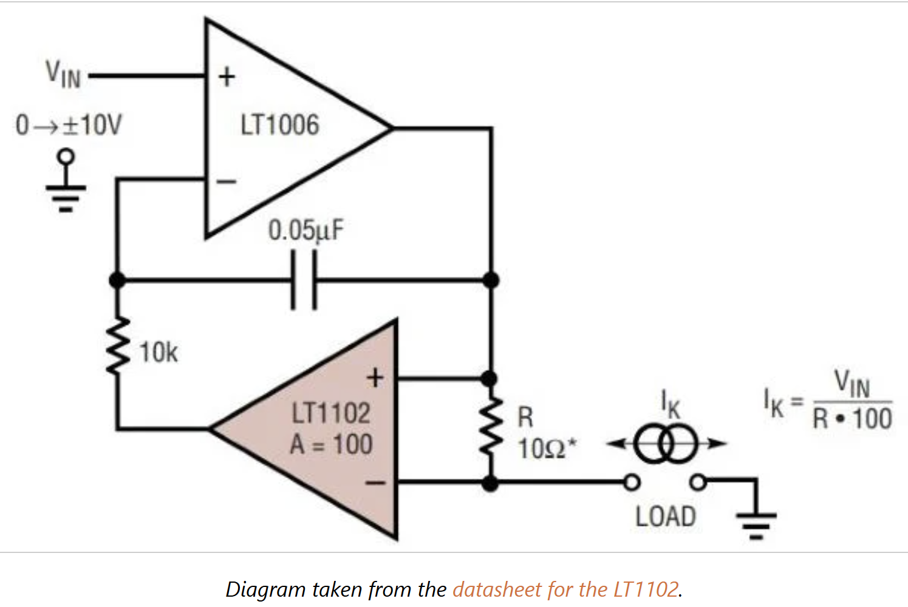
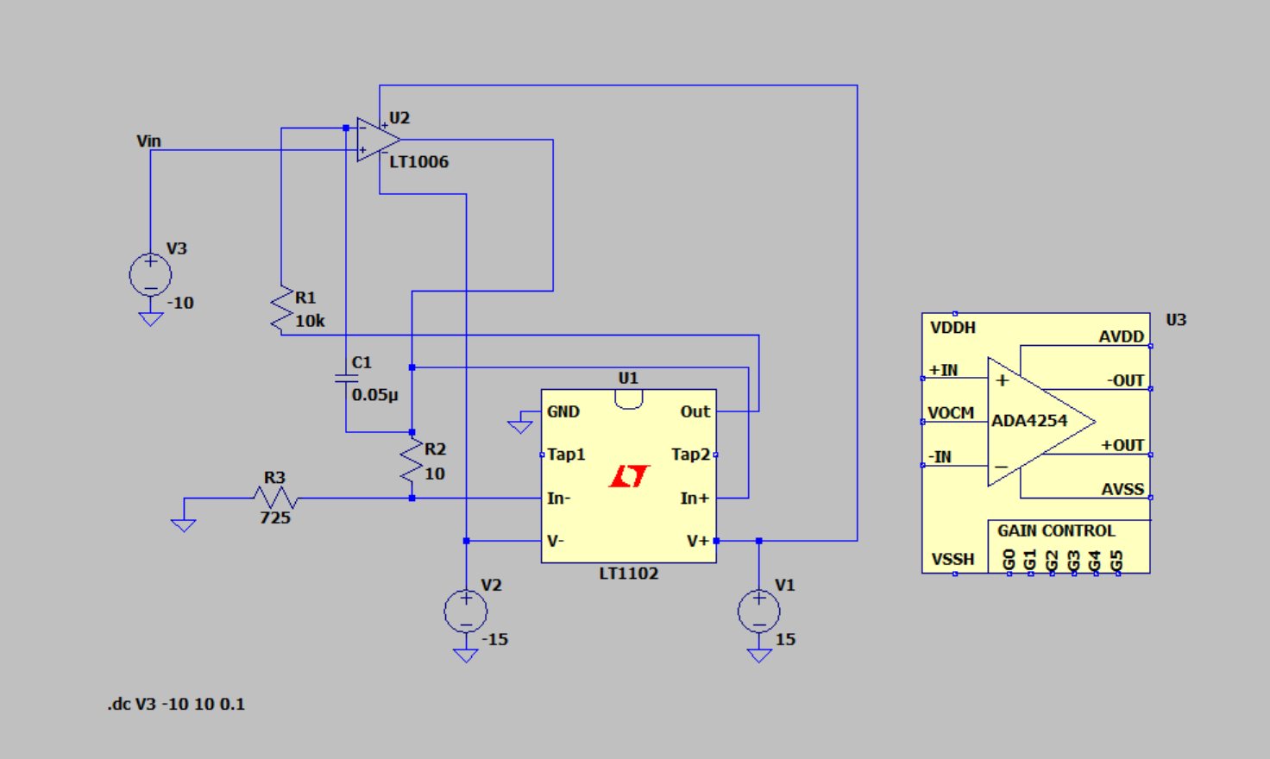
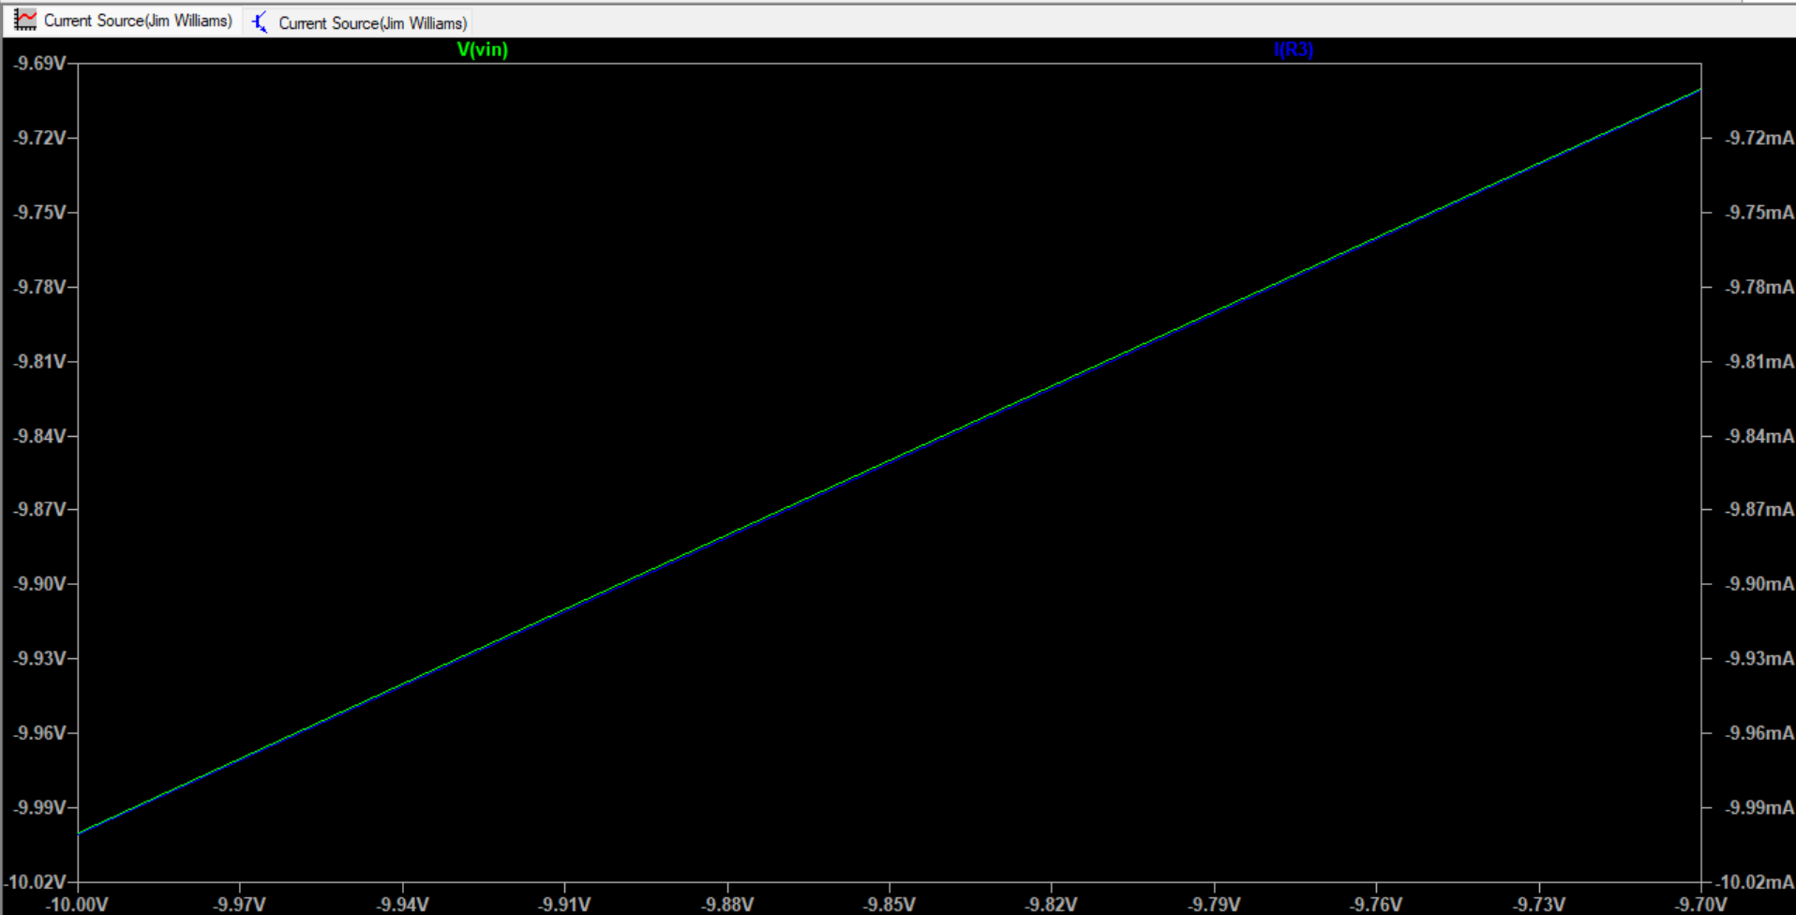
Working Current Source
Need to figure out better op amps for higher load
Max load resistance right now is around 725Ohms

Slide 6
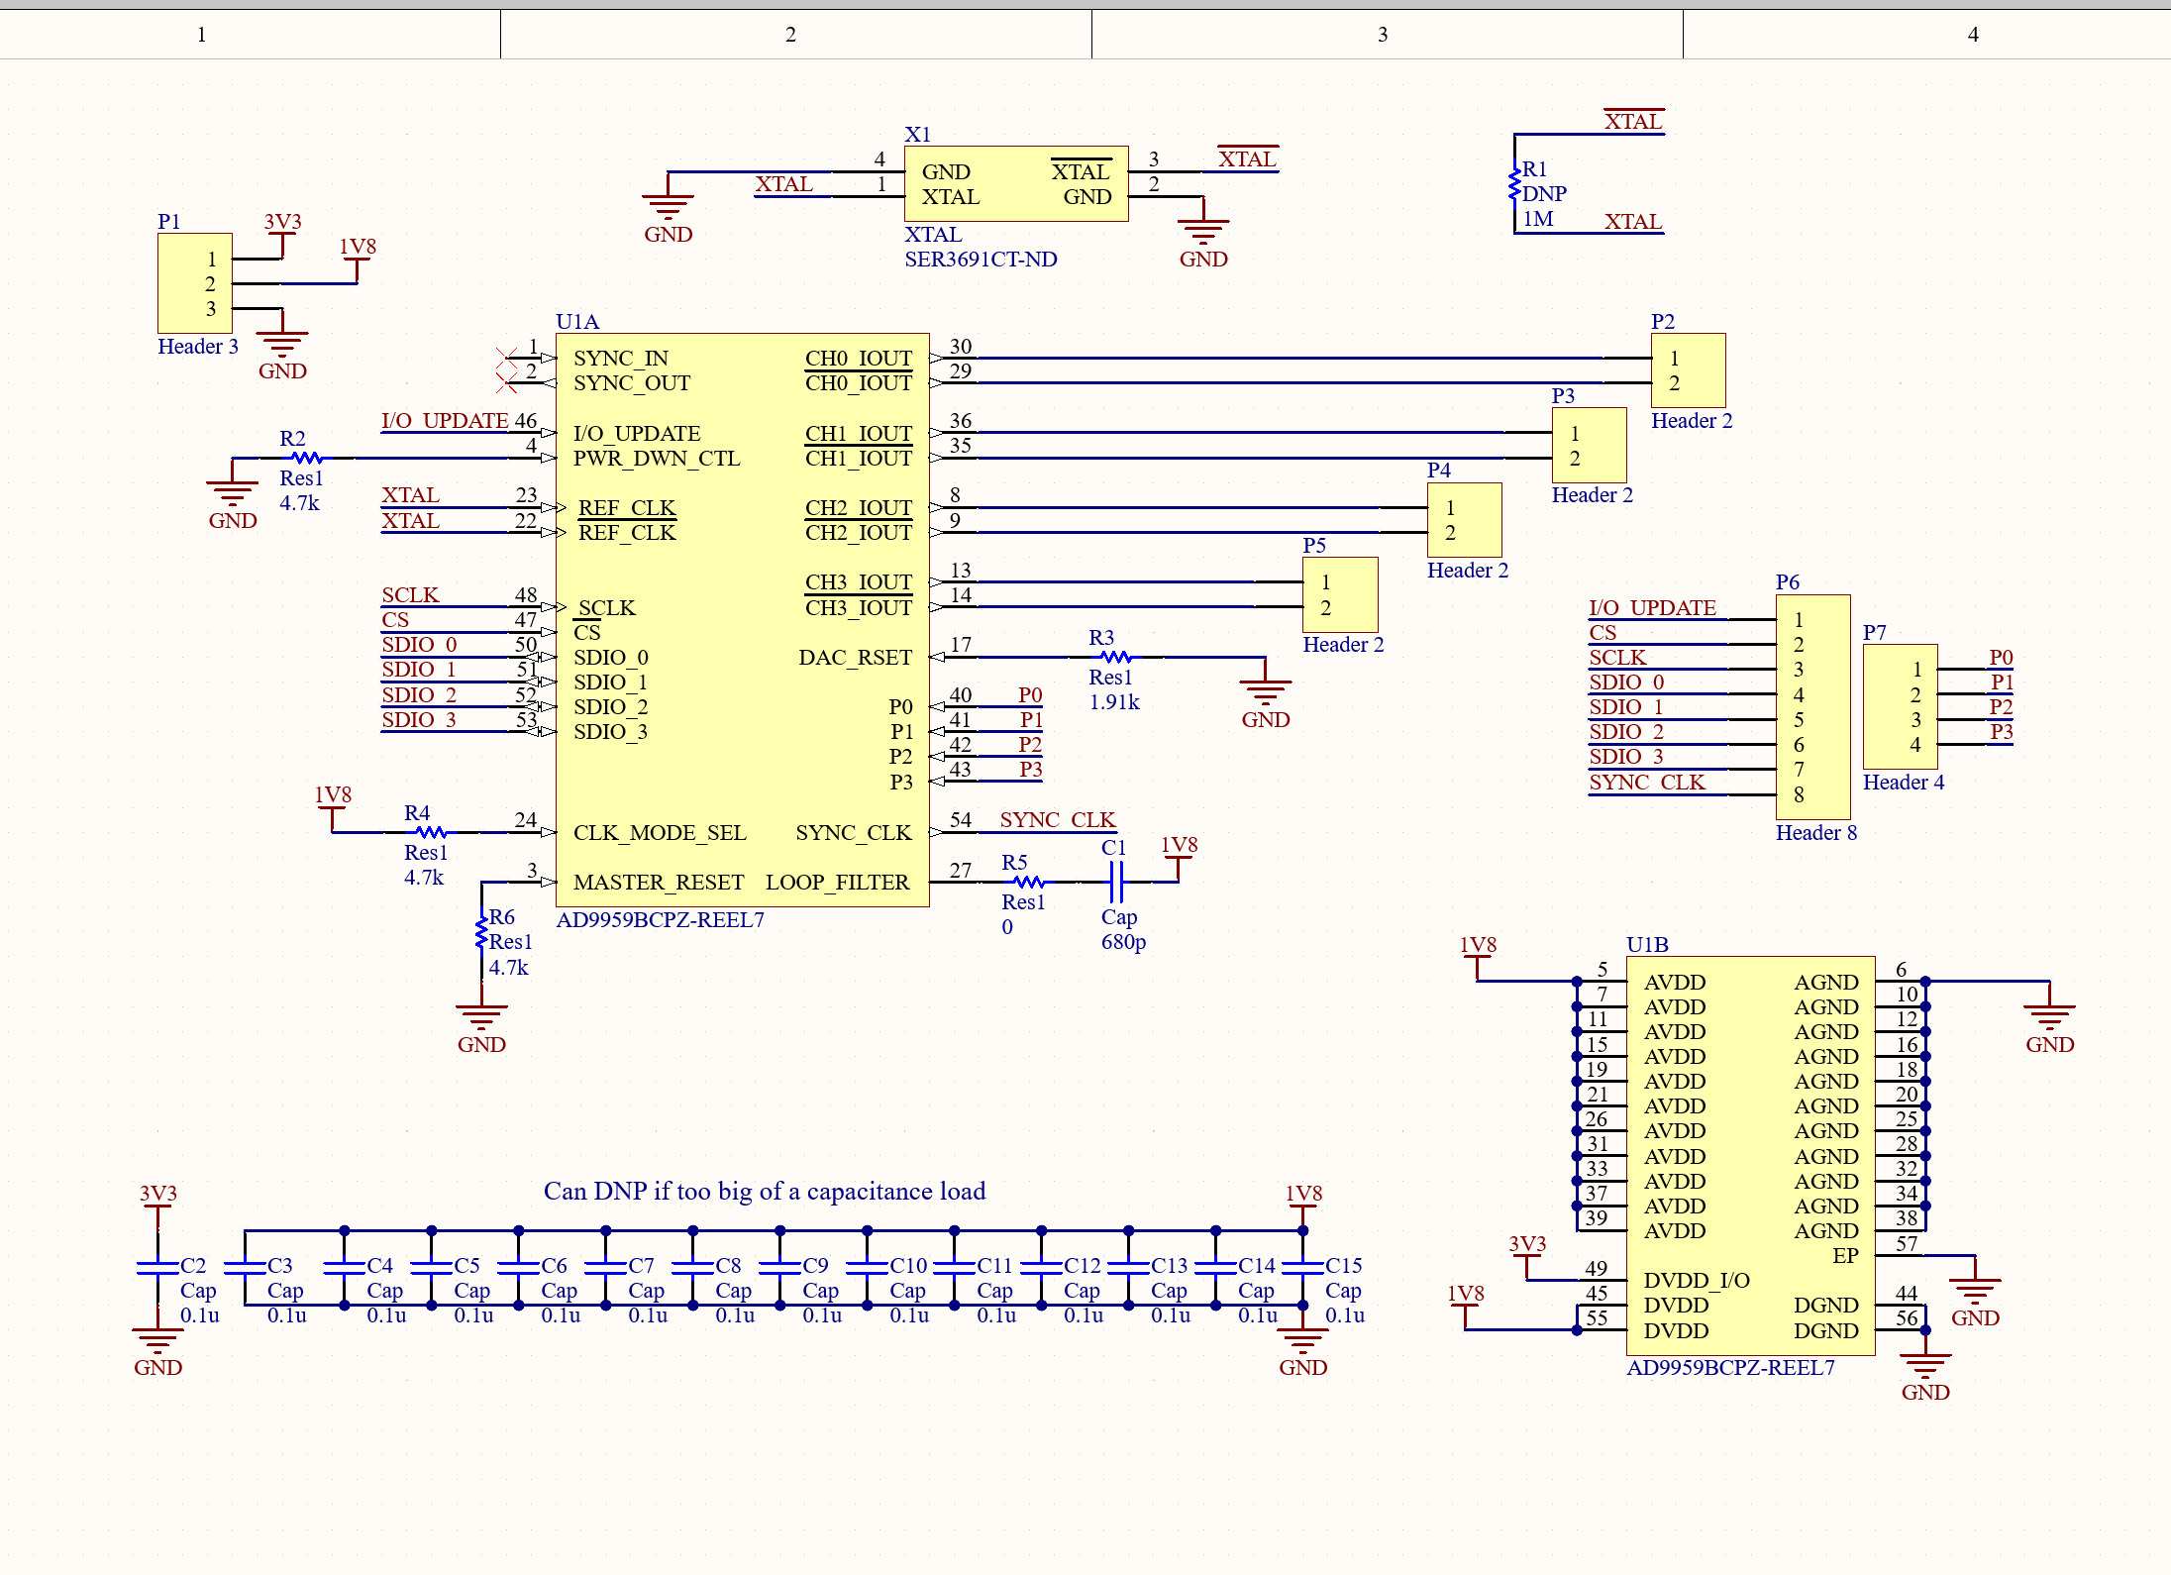
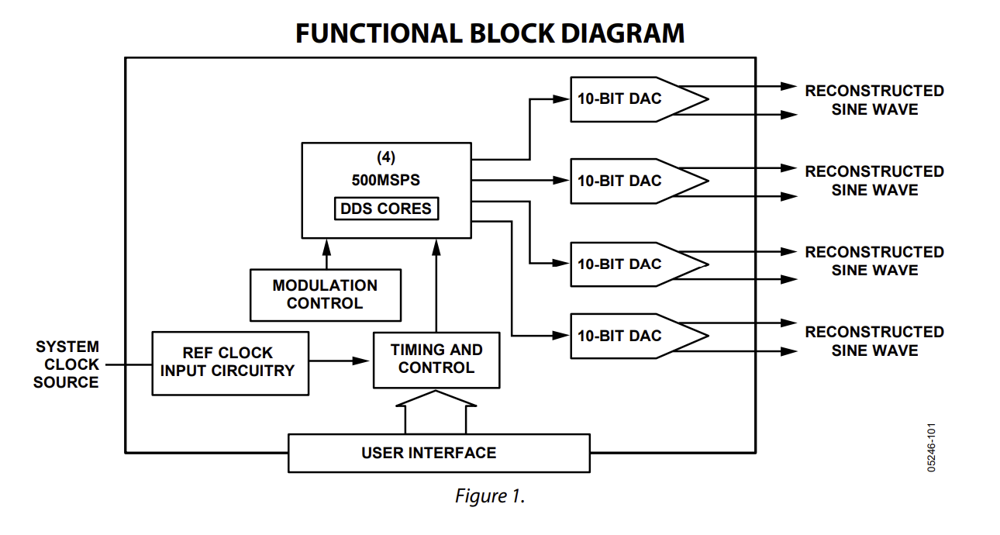
DDS Module

Slide 7
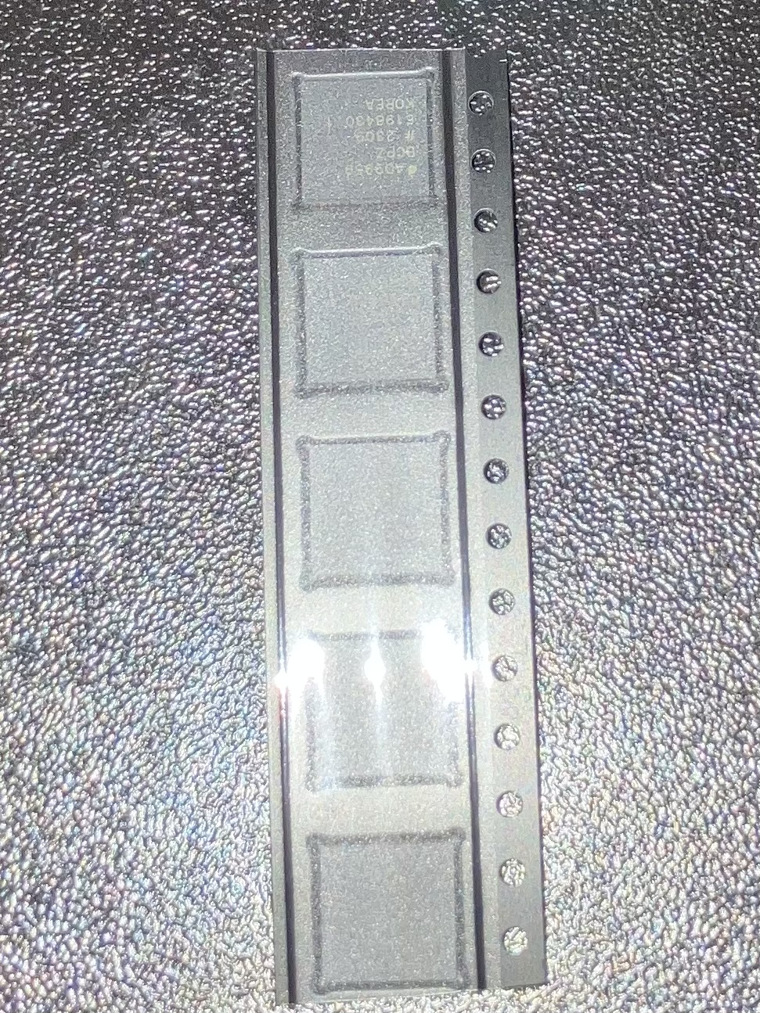
DDS Module

Slide 8
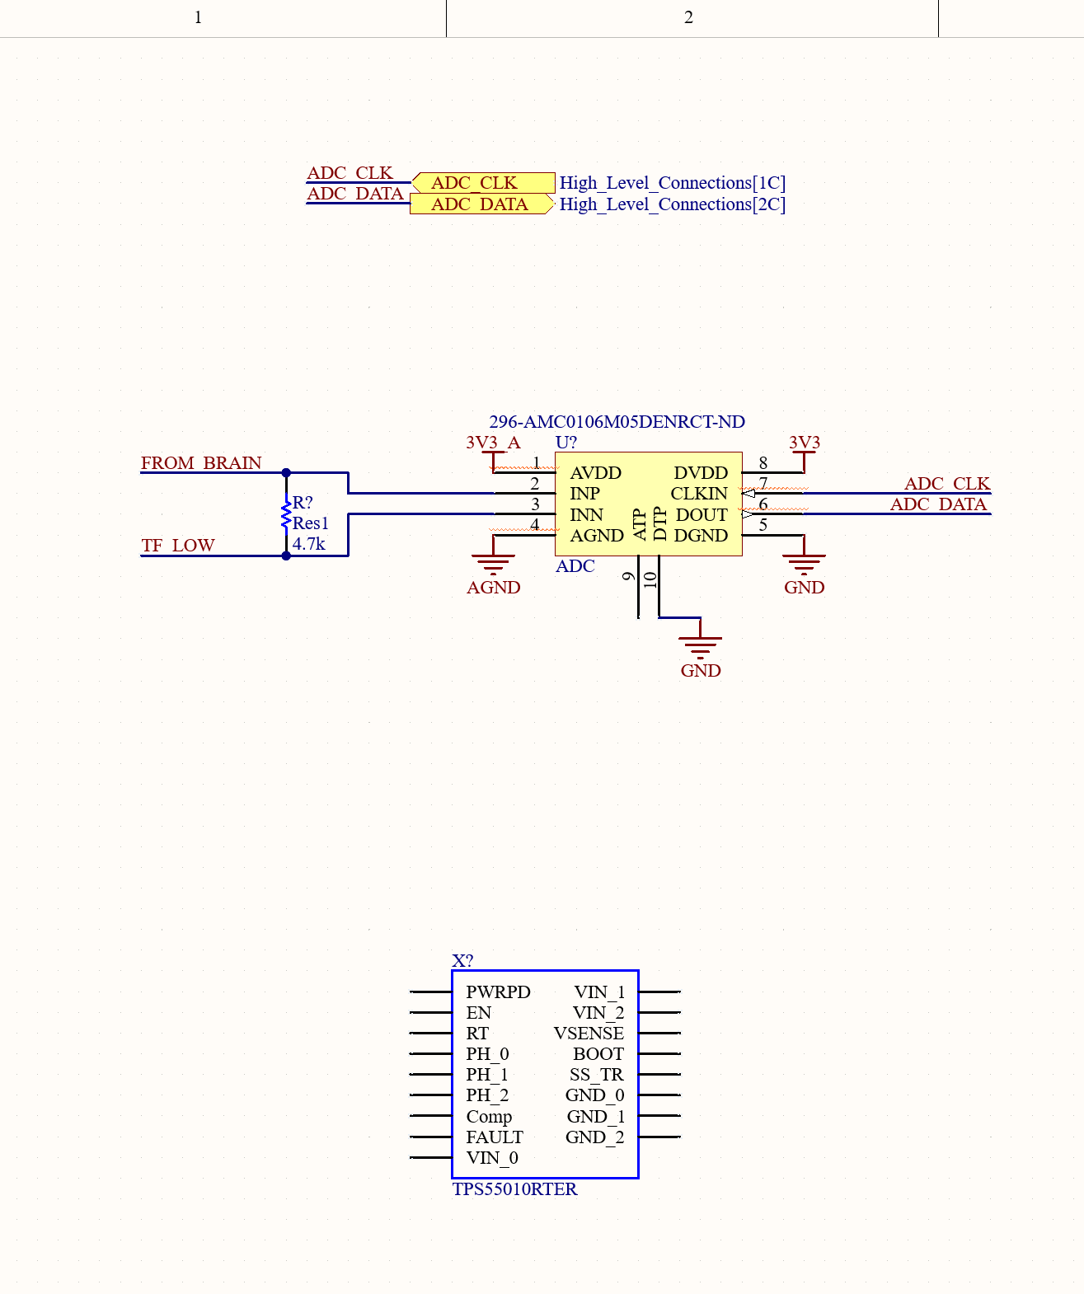
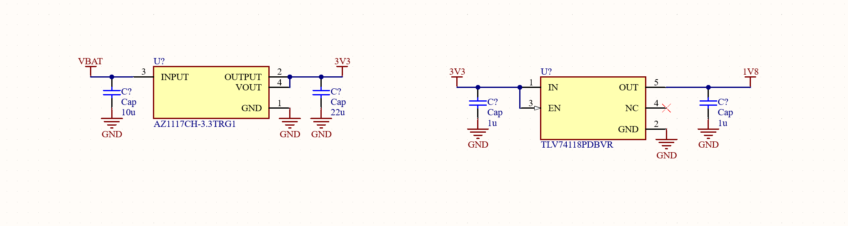
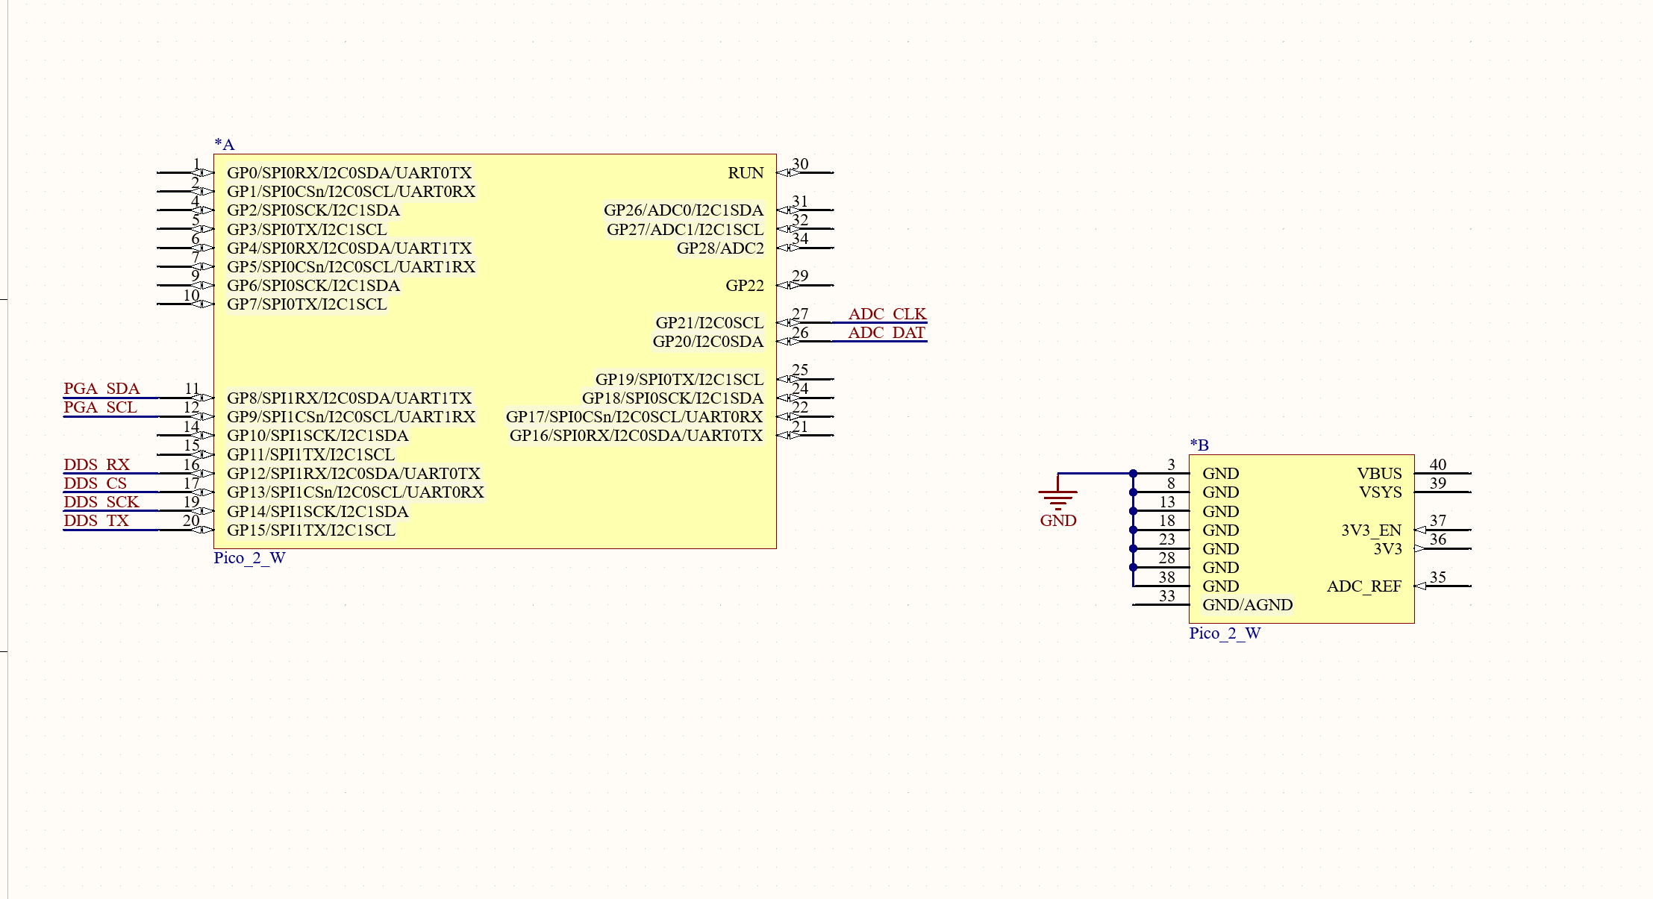
Schematic Updates

Slide 9
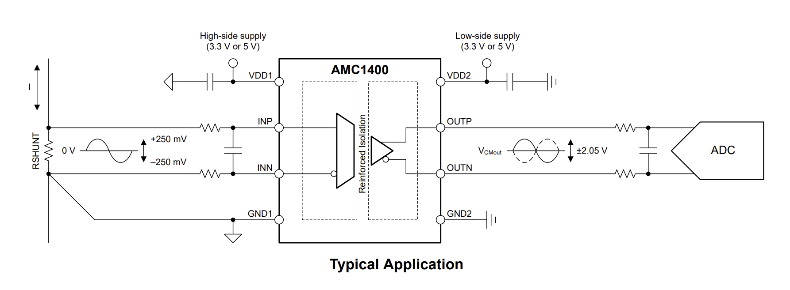
ADC
Need isolation for safety
Should be able to communicate with MCU directly

Slide 10
Plans for Isolation
Use isolated amplifier through a transformer
Read output current and use a control loop to monitor and adjust output

Slide 11
Plans for Battery
Calculate required amp hours to narrow search
Find something with integrated BMS

Slide 12
Challenges so far
Height limit with isolation transformers
Current source circuitry

Slide 13
Immediate Plan
Continue schematic and symbol creation
Find battery for device
Find components for Jim Williams source that handle high voltage and simulate
Determine board measurements for housing

Slide 14
Questions/Feedback

